Slide 1

BANK ANALYTICS PROJECT

Slide 2

AGENDA
INTRODUCTION
SCOPE
KPI’s & INSIGHTS
DASHBOARDS in EXCEL, POWER BI & TABLEAU
SQL OUTPUTS
CONCLUSION

Slide 3



INTRODUCTION
This project involved analyzing Customer bank loan data. We were given two .csv files, each containing 39,000 rows, with the goal of assessing the bank's growth in loans over the specified years. To achieve this, we used MS Excel and MySQL for data analysis, cleaning, and removing duplicates.
We then created interactive dashboards using Tableau and Power BI, performing calculations and merging data to visualize the results effectively.

Slide 4
In preparing our dataset for analysis, we undertook a series of cleaning and transformation steps before processing the data. The initial and critical step was to data model the two datasets, which was followed by thorough data cleaning to ensure the accuracy and relevance of the information. Here’s an overview of the key actions taken:
In preparing our dataset for analysis, we undertook a series of cleaning and transformation steps before processing the data. The initial and critical step was to data model the two datasets, which was followed by thorough data cleaning to ensure the accuracy and relevance of the information. Here’s an overview of the key actions taken:
Data Modelling: Formed a one to one relationship between Finance_1 and Finance_2 using the common ID column.
Handling Missing Values: Identified and addressed missing data to avoid bias.
Removing Duplicate or Irrelevant Columns: Eliminated duplicate columns to avoid redundancy and removed those that did not add value to the analysis or fell outside the project scope.
Ensuring Data Consistency: Standardized data formats and units across the dataset.

Slide 5

SCOPE
The primary objective was to translate key performance metrics (KPIs) into straightforward visualizations. The goal was to design clear charts and graphs that effectively represented these KPIs and made it easy for everyone to understand the company's performance. This task drove us to refine our data analysis abilities and improve our skills in visual communication, ultimately facilitating more informed decision-making based on the data.
In our presentation today, we will guide you through a complete comprehensive analysis of the data, offer insightful perspectives, and provide suggestions for stakeholders in the banking sector. We will emphasis the key data findings and present practical suggestions aimed at enhancing decision-making in the banking sector. Our goal is to leverage these data insights to foster better risk management and encourage sustainable banking practices.

Slide 6





KPI’s
YEAR WISE LOAN AMOUNT STATUS
KPI 1
GRADE WISE SUBGRADE WISE REVOLVING BALANCE
KPI 2
KPI 3
TOTAL PAYMENT FOR VERIFIED STATUS vs TOTAL PAYMENT FOR NON VERIFIED STATUS
KPI 4
STATE WISE & MONTH WISE LOAN STATUS
KPI 5
HOME OWNERSHIP vs LAST PAYMENT STATUS

Slide 7
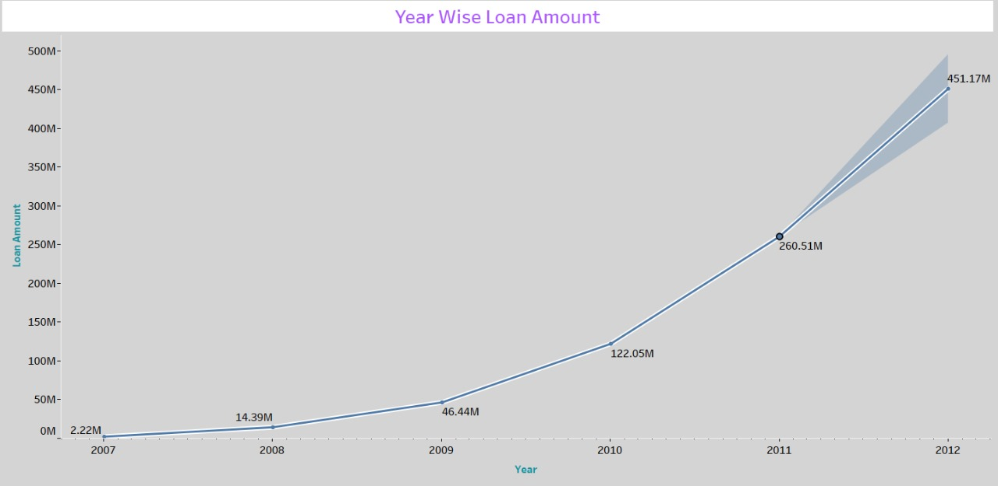
KPI 1 - YEAR WISE LOAN AMOUNT STATUS
The visual clearly indicates a yearly increase in the loan amount. Starting at $2M in 2007, the loan amount grew to $261M by 2011, reflecting an increase of around $258M over 4 years.
The continuous rise in loan amounts emphasizes how important it is to have a solid financial strategy and practice risk management in order to efficiently address the rising demand.
By using Forecast Feature in Tableau loan Amount in 2012 can be predicted. It can be reach up to 451 M.

Slide 8
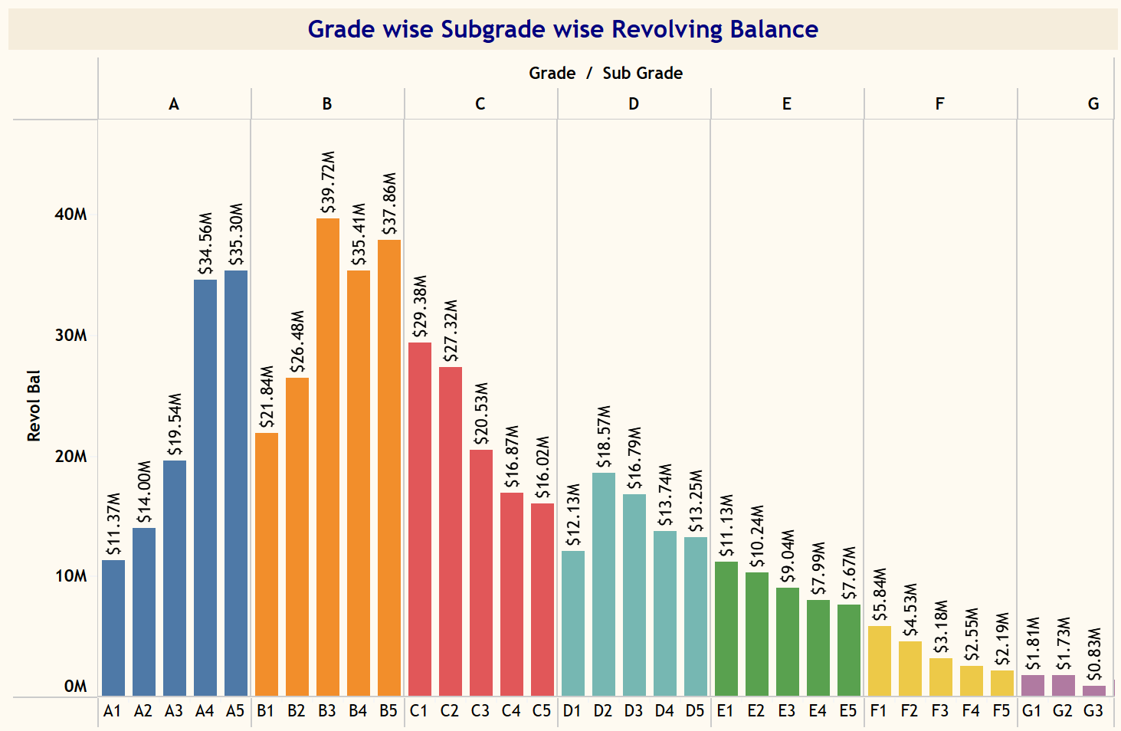
KPI 2 - GRADE WISE SUBGRADE WISE REVOLVING BALANCE
It is evident that customers of Grade-B has the highest revolving balance compared to other grades, while Grade-G has the lowest. High revolving balances may indicate that a borrower is relying too much on credit. That is why it is important to keep revolving balances to a minimum. This calls for increased supervision and potentially focused financial management assistance by the bank.
A consumer who uses too much of the credit extended to them can hurt his credit score.
This pattern generally follows the order of B > A > C > D > E > F > G in terms of revolving balance relative to annual income.

Slide 9
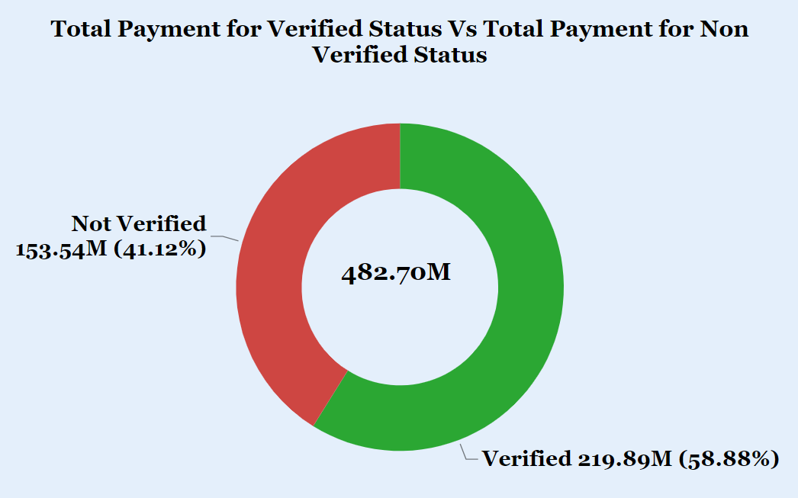
KPI 3 - Total Payment for Verified Status vs Total Payment for Non Verified Status
This is the initial stage of the verification process. To begin collecting and verifying documents, the bank requires a loan application.
The donut chart reveals that 58.88% of the total payments are marked as Verified, while 41.12% are Not Verified for the total loan amount of $482.70M.

Slide 10
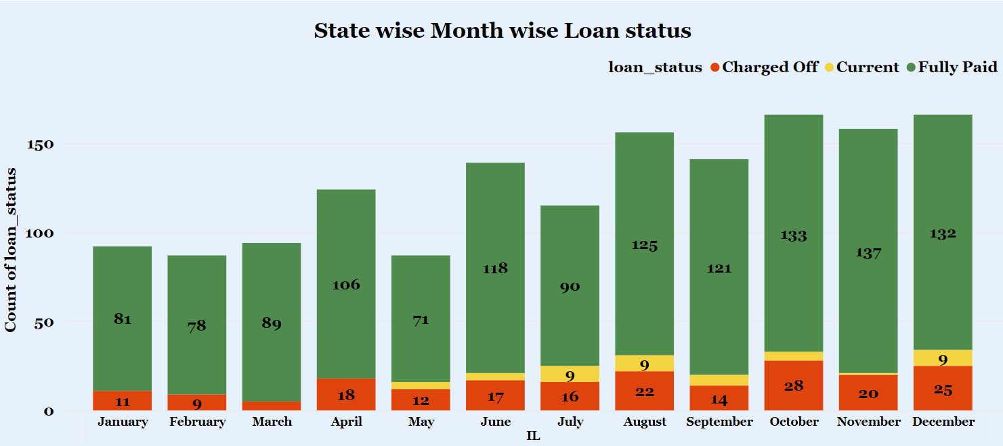
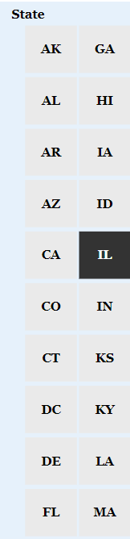
Kpi 4 -STATE WISE & MONTH WISE LOAN STATUS
The visual displays loan statuses by state and month, allowing the bank to pinpoint regions or times with elevated delinquency rates and respond accordingly. The State California (CA) has maximum number of loans issued and the state Maine (ME) has the least number of loans issued. The month of December and February has maximum and minimum number of loans issued respectively. “Fully Paid” has the highest count of loan statuses at 32,950, followed by “Charged Off” at 5,627, and “Current” at 1,140.

Slide 11
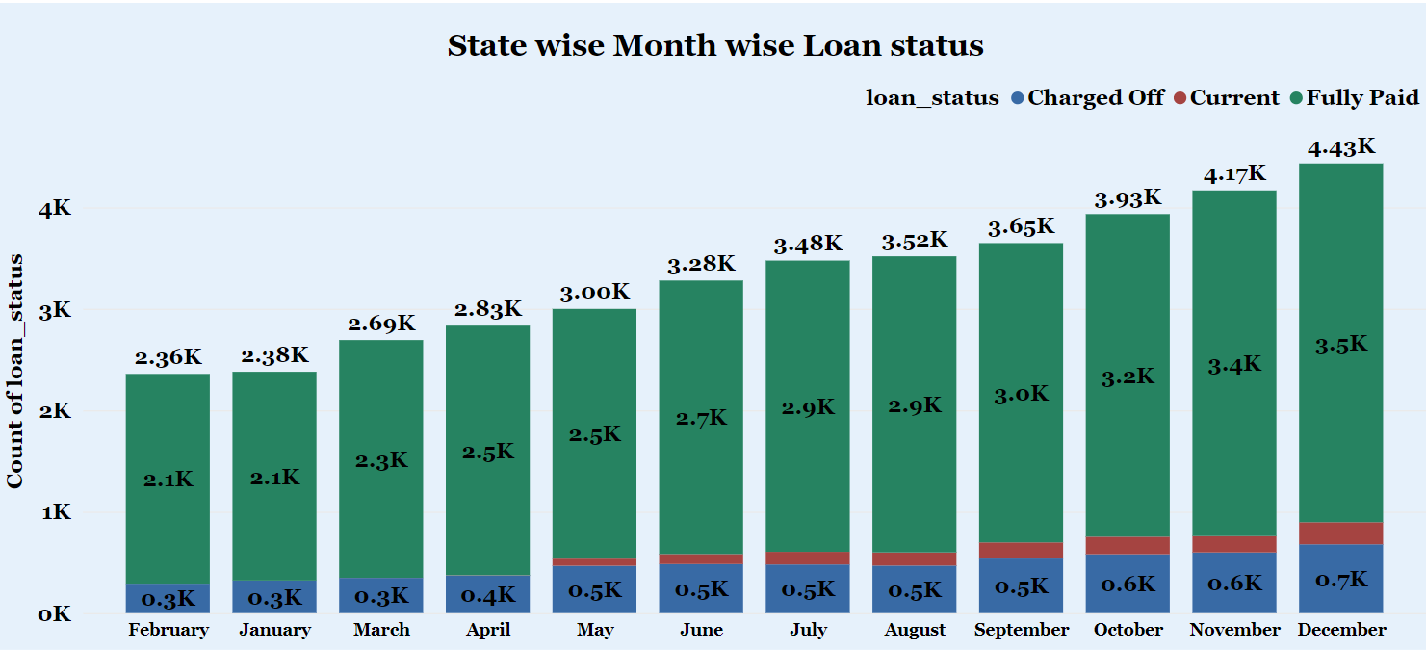
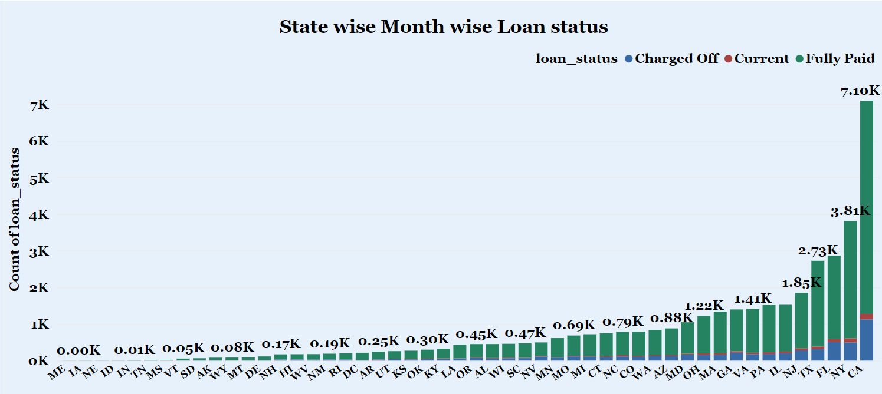

Slide 12
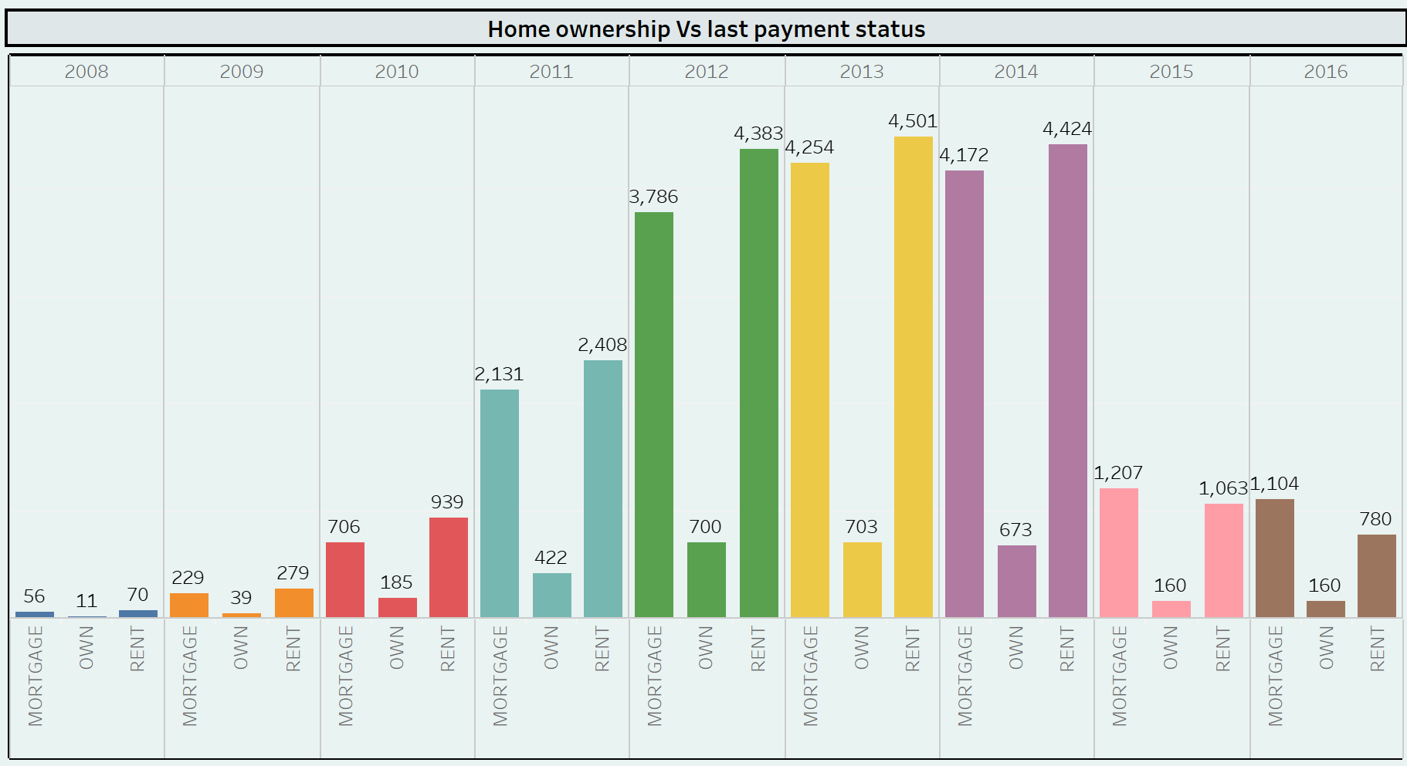
Kpi 5 -HOME OWNERSHIP vs LAST PAYMENT STATUS
The status of home ownership and the amount paid on the most recent payment date are depicted in the graph on the left. Out of all house ownership, mortgages had the most intriguing recent trajectory. They began to rise in 2008 and increased by 3,705.36% (2,075) in just three years. This suggests that a sizable portion of clients are almost finished repaying their loans in order to acquire their particular homes.

Slide 13
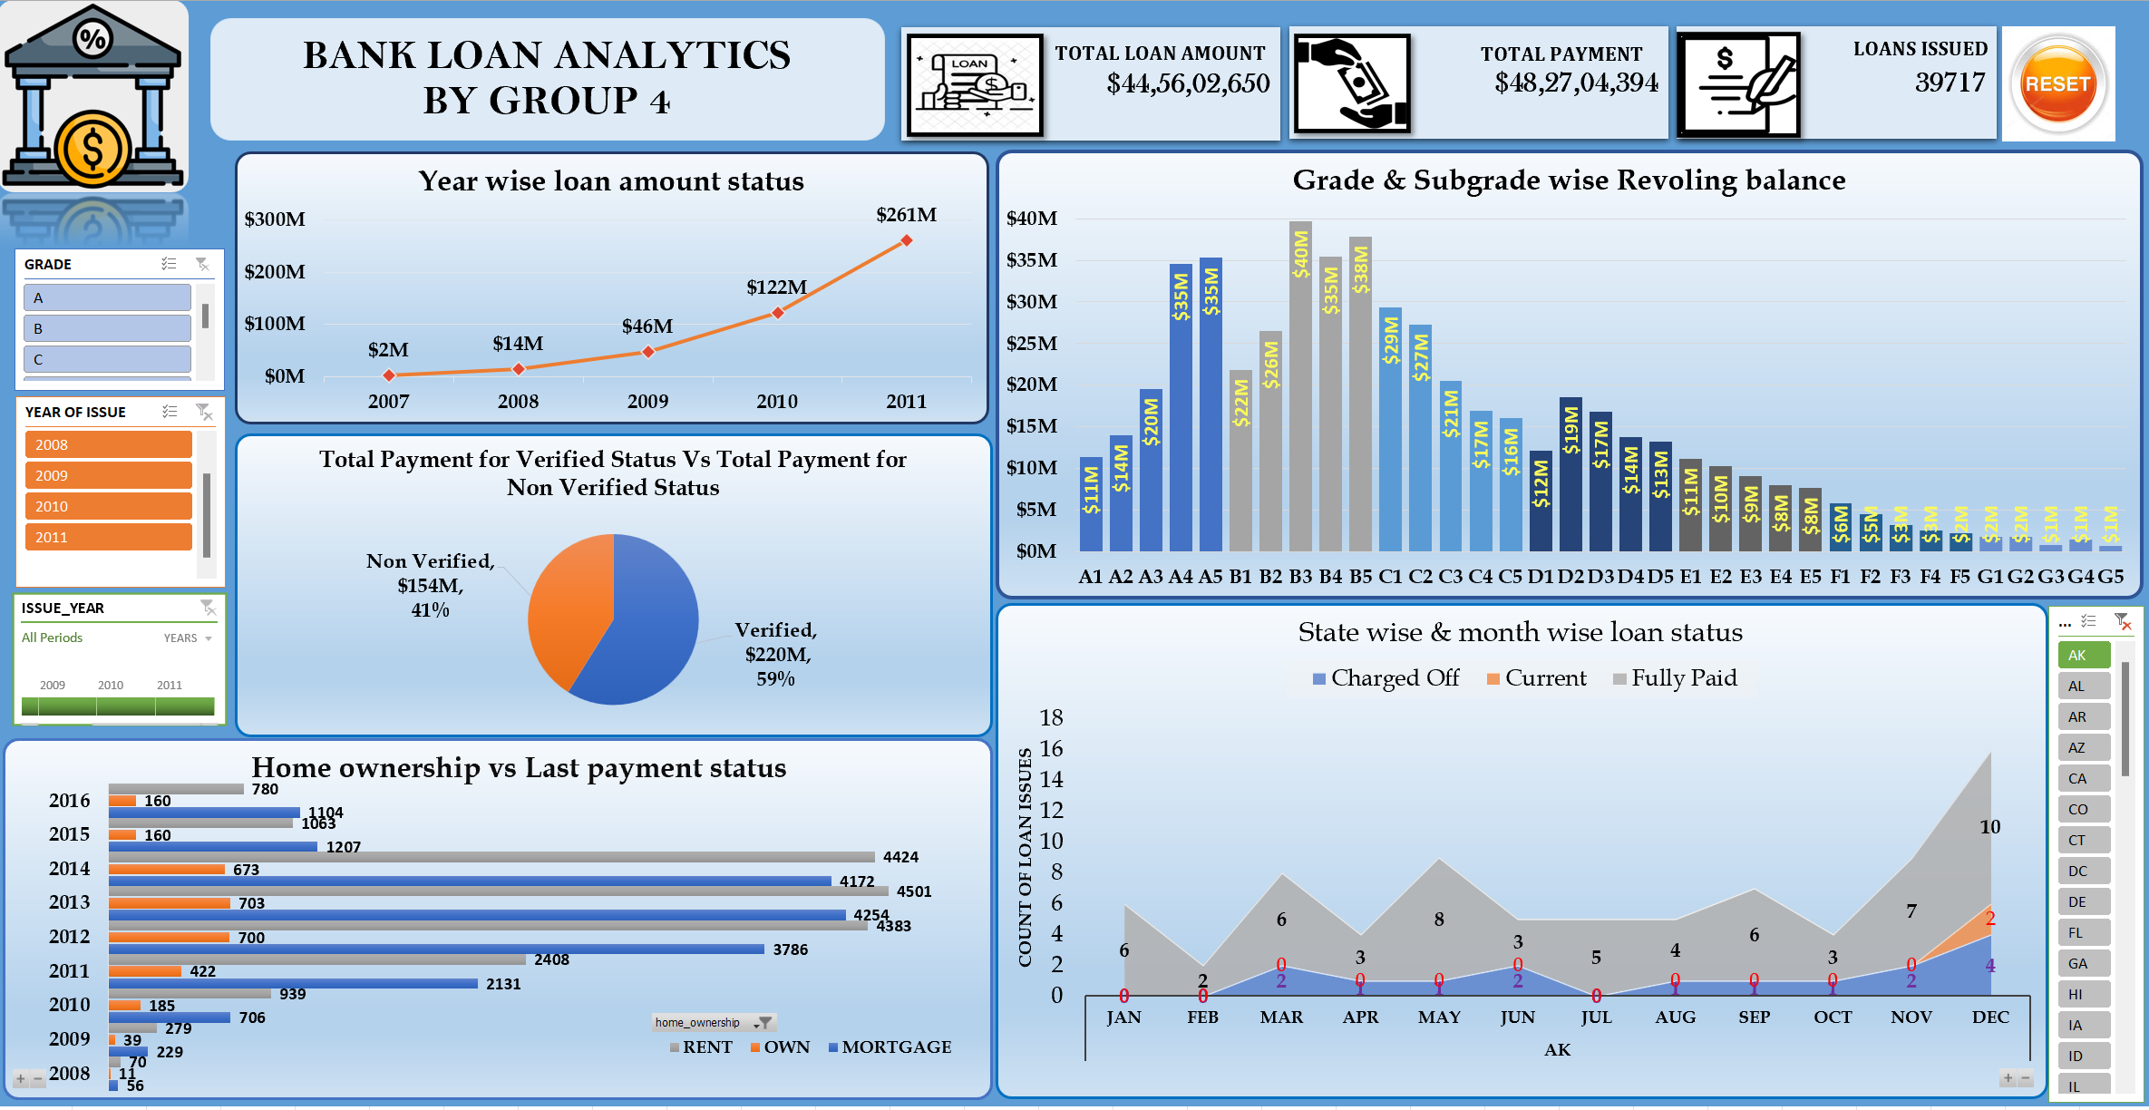
DASHBOARD IN EXCEL

Slide 14
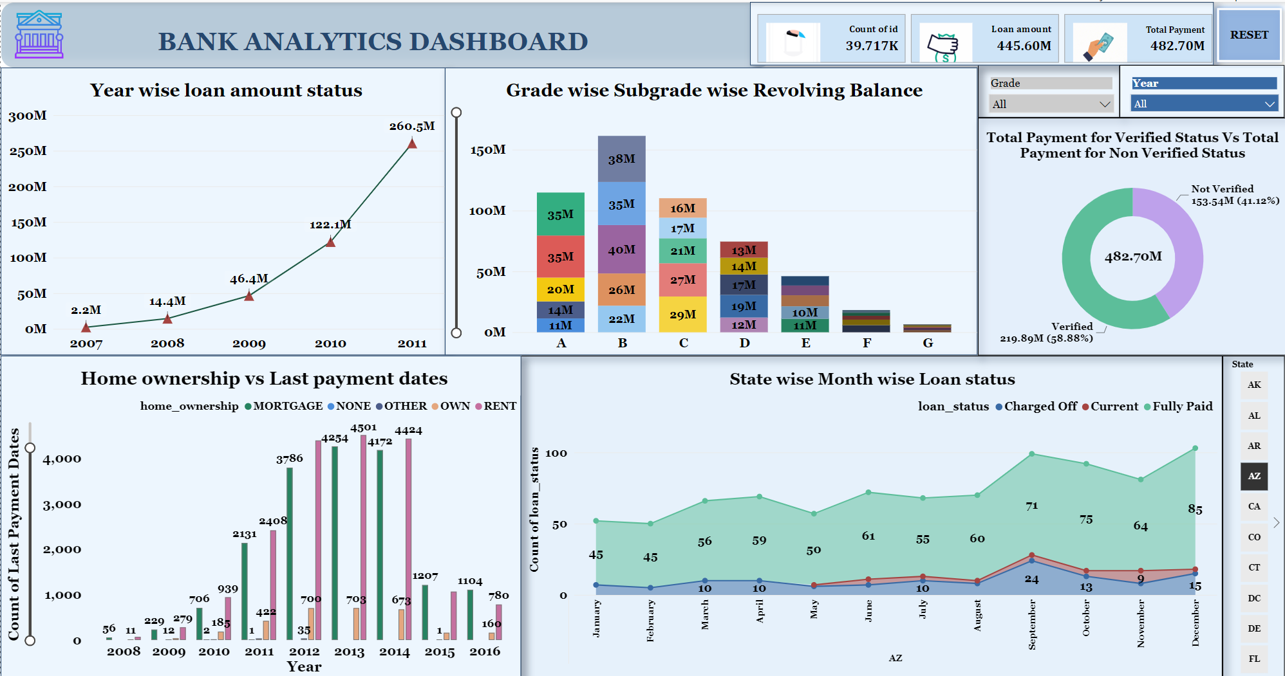
DASHBOARD IN POWER BI

Slide 15
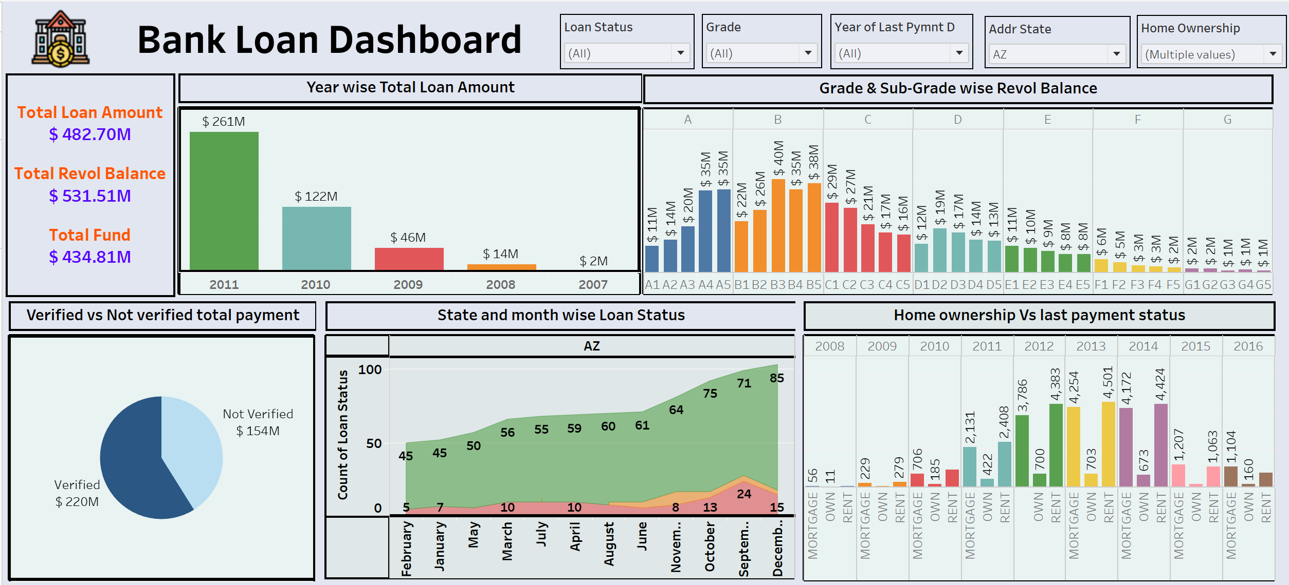
DASHBOARD IN TABLEAU

Slide 16
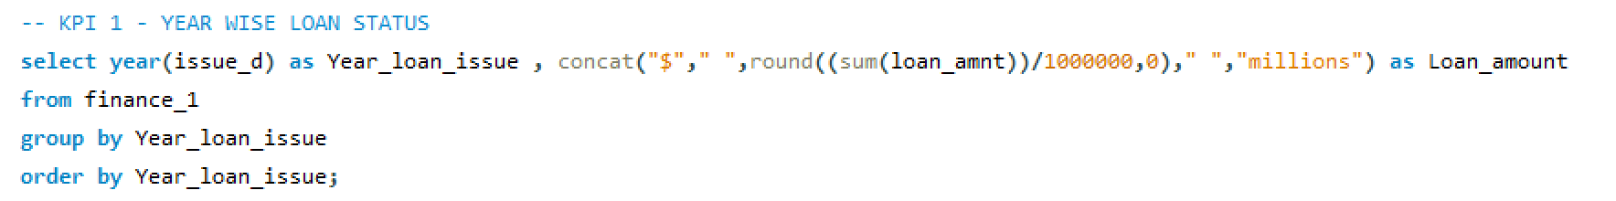
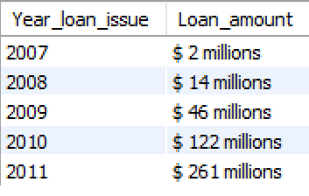
SQL OUTPUTS

Slide 17
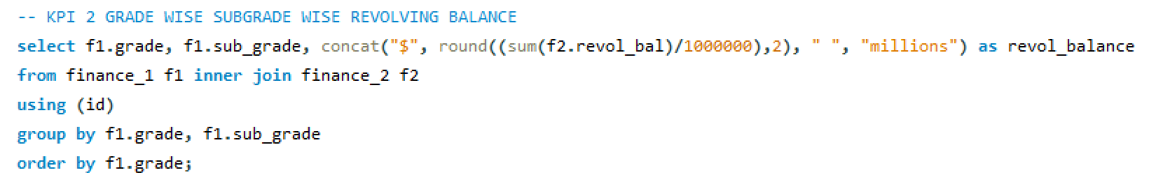
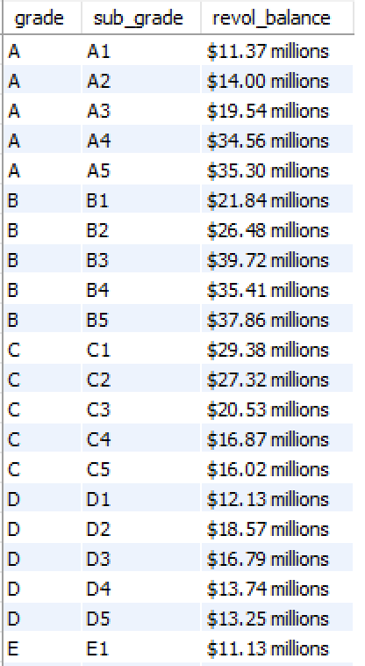

Slide 18
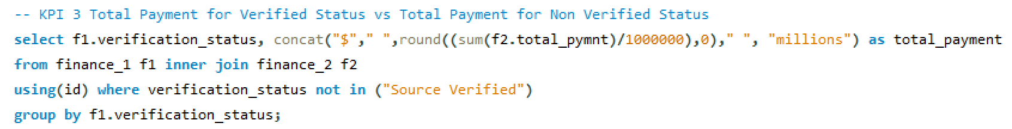
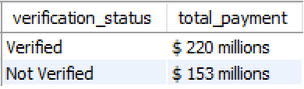

Slide 19
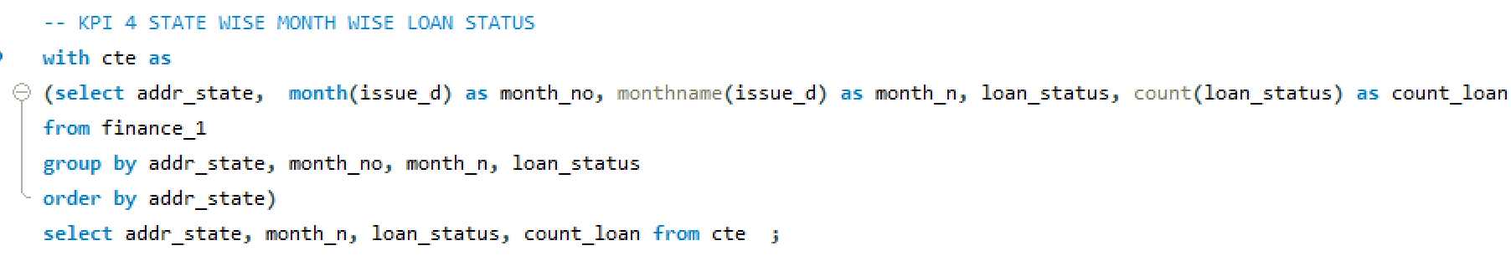
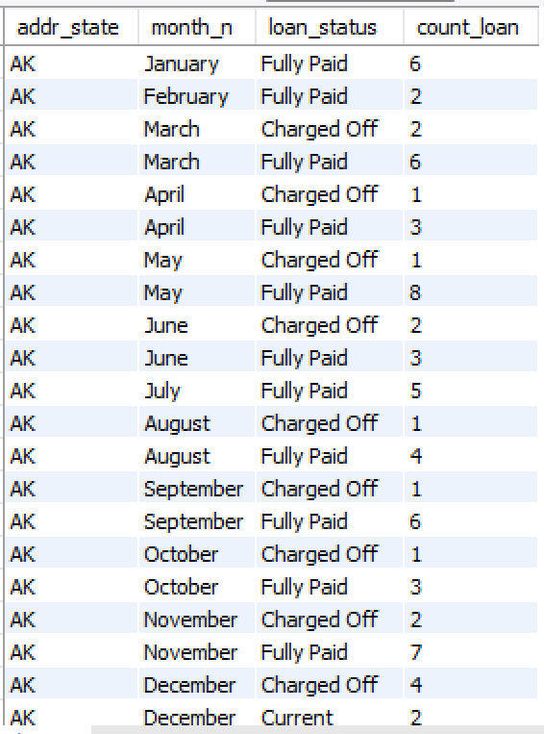

Slide 20
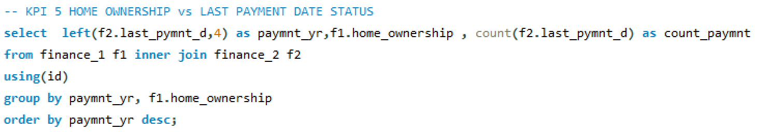
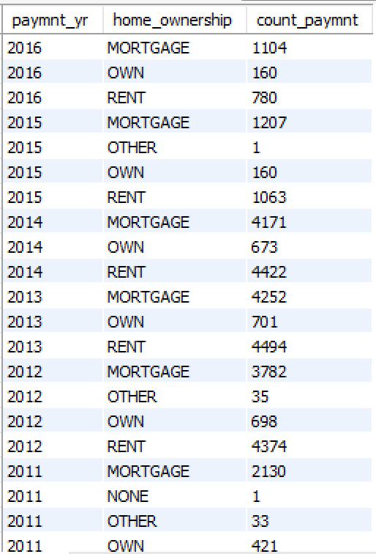

Slide 21
CONCLUSION
Increase in Year wise loan amount trend might be attributed to rising financial needs or growing confidence in the Bank. The ongoing increase in loan amounts highlights the necessity for strong financial planning and risk management to handle the growing demand effectively.
The observation that customers with grade B have the highest revolving balance, whereas those with grade G have the lowest, underscores the differences in credit usage among various credit grades. This indicates that grade B customers are more dependent on revolving credit, which may necessitate closer monitoring and possibly targeted financial management support. On the other hand, grade G customers might either have lower credit limits or be more cautious with their credit usage.

Slide 22
Verified accounts make a notable contribution to total payments, but non-verified accounts, despite comprising a larger percentage of the total, also contribute more in terms of payment volume. This difference underscores the role of account verification in understanding and managing payment behaviors. Promoting account verification among customers could enhance payment reliability and mitigate risk.
The study indicates that California (CA) leads with the highest number of loans issued, while Maine (ME) has the fewest. December sees the highest loan issuance, whereas February has the lowest. Among loan statuses, “Fully Paid” leads with 32,950 entries, followed by “Charged Off” with 5,627, and “Current” with 1,140. To mitigate potential losses, it is crucial to address the high number of charged-off loans by enhancing credit assessments and implementing stronger support mechanisms.

Slide 23
The data underscores the importance of mortgage loans in the housing market, given their larger loan amounts compared to other home ownership categories. Examining the last payment date helps evaluate payment timeliness and identify potential repayment patterns within each category of home ownership.

Slide 24
THANK YOU

